Slide 1
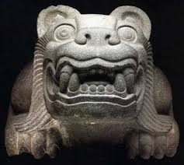
Becoming Mexican American
Race and Ethnicity, Culture, and Identity in Chicano Los Angeles 1900 - 1945
George J. Sanchez
Notes:
Book by George J. Sanchez / Oxford University Press. 1993, 367 pgs.

Slide 2
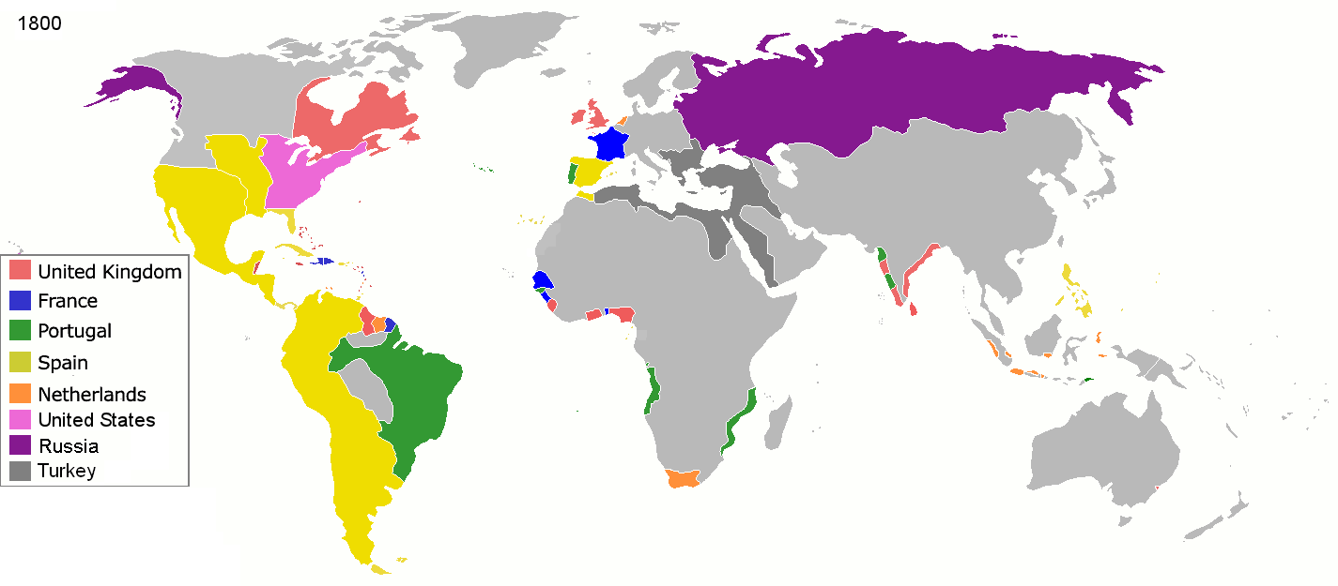
Mexico – historical sketch
Pre-Colombian – Olmecas 3,000 B.C. / Aztec Empire (Tenochtitlán in 16th Century)
Spanish Conquest – Cortés vs. Moctezuma 16th – 17th Centuries / Mexico City
Colonial Vice-kingdom (Virrey de Nueva España): 1535 – 1808
Mexican Independence (from Spain) 1821
Mexican Northern Territories (TX to CA) WAR – 1845-48 (6,000M vs 13,000US)
Treaty of Cahuenga, signed in Los Angeles in 1847 (Polk)
U.S. Invasion of Veracruz (Halls of Moctezuma)
Porfirio Diaz – El Porfiriato (35-yr dictatorship, U.S. Industrialization, peasant expropriation)
The Zimmerman Telegram – 1917, Kaiser Wilhelm offer to Mexico (U.S. Territory) for allegiance

Slide 3
Table of contents
1. Crossing Borders 17 – 86
2. Divided Loyalties 87 – 128
3. Shifting Homelands 129 - 208
4. Ambivalent Americanism 209 - 253
Notes:
Homeland in many cases WAS what is now U.S. territory – Mexico lost its Northern Territories (Colorado, Utah, Nevada, Texas, New Mexico, Arizona, and Southern California) to the Mexican-American War. On July 4th, 1848, with the ratification of the Treaty of Guadalupe Hidalgo by the Mexican Congress, these vast new territories were incorporated as part of the United States. Mexico got $15M out of the surrender, insufficient to replace lost population and destroyed infrastructure. These shifting post-war borders wreaked havoc among the northern Mexican population, which included ranchers, farmers and miners.

Slide 4
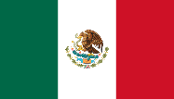
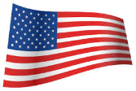
1. CROSSING Borders
By 1900, nearly ONE and a Half Million Mexicans (a TENTH of the population) had emigrated to USA, disrupting the Mexican economy even further
Early 1900’s vast expanses of irrigated farmlands were built in the Southwest; mining in AZ, CO, OK and CA; curtailment of Euro & Asian immigration = MORE Mexican immigrants
USA – Mexico railways* = labor shuttles into San Antonio – New Orleans, El Paso, Tucson, and San Diego – Los Angeles
Major disruption (small farmers, muleteers, millers, craftsmen disappeared to industrial farming, railways, food processing factories, manufacturing) = AMERICANIZATION of the 19th century Mexican society, Porfirio Diaz’ vision
El Paso, 1910: “Just give your name and where you were going.” Inspectors were only concerned about Chinese and LPC’s (Likely to Become a Public Charge)
All about remittances – mostly male laborers, traded through Labor Agencies
By 1917 bathing/de-lousing/vaccination was implemented by Public Health Svc.
Immigration Act of 1917 = Head Tax = Spike in Illegal Immigration and NO Return
Los Angeles as Hub – by 1930’s MOST Mexican Settlers into LA had been in USA for over 5 years, and RE-settled into LA from working in Texas
Los Angeles was a haven for Anglo-Saxons into CA: West=Anglo / East=Mex-tex
Notes:
* Heavy U.S. investment into Mexican railways by American industrial tycoons, turning Mexico into an economic appendage of the United States.

Slide 5
2. DIVIDED LOYALTIES
The GOAL is to one day reincorporate bi-lingual, highly skilled Mexican Americans into Mexico to produce a level of superior life*
Americanization programs were designed to transform the values of Mexican immigrant, and Mexicans, like Europeans, were seen as assimilable, unlike Asia’s Chinese and Japanese immigrants
By 1929 LA surpassed all other western cities in manufacturing = population boom, and male laborers were Americanized through their workplace
In 1920’s-30’s women immigrants in CA were Americanized through Home Teachers
Replace Mexican diet – “a child’s lunch of a folded tortilla could lead to crime” with balanced diet conducive to well-behaved, constructive citizenry
Mexican children segregated through IQ testing in English
Funding for Americanization programs vanished in the 1930’s / Renewed Mexican Ident
LA hit by Great Depression in 1930 = Movement to REPATRIATE Mexicans, Consul Rafael de la Colina / by the Trainload – 150,000 “Angelinos” in the early 1930’s
In the 40’s, LA MexicanAmerican “Chicanos” acclimated & saw themselves as American citizens but preserved their “Mexican Soul” through customs, language, religion and a deeply rooted love of their native land.
Notes:
*Editorial in La Opinion of Mexico City, June 21, 1930.

Slide 6
3. SHIFTING HOMELANDS
Single male migrants initiated most Mexican migration, and were thus more likely to return to Mexico with funds to marry and settle
When marriage occurred in the U.S., ties to the families of origin became secondary
Mexican women migrating to the U.S. were generally confined within Mexican family
In 20’s & 30’s LA, abundance of marriage partner possibilities: from different Mexican locales, American-born Chicanos, other immigrant groups, Anglo-LA (more rarely, usually immigrants from Mexico City).
Mexicans were traditionally Catholic (Spanish tradition), but during Porfiriato Protestant sects, to include Methodist, Presbyterian and Mormon, were “imported” to foster Protestant “work ethic”
CCD – Confraternity of Christian Doctrine became important, imparting “American” Catholicism, instructed in Spanish, to large Chicano communities in American “barrios”
Music “mass-culture” emerged for Chicano community, and radio producers filled dead air time to cater to Chicano audiences
New 1930’s Chicanos experienced the “dance craze”, shunned by parents – this contrasted with life in Mexico, where the youth had few outlets for juvenile expression
Vast majority of Mexican immigrants did not leave the working class, yet cultural adaptation did occur – adoption of “Tough Pride” to deal with grueling work
A “white collar” musician class emerged to deliver Chicano music throughout LA
In late 30’s and 40’s wives and older children often became sources of supplemental income, and further, deeper integration into American society

Slide 7
4. AMBIVALENT AMERICANISM
“We’re not awakening ourselves for Mexico nor the United States, but for ourselves”. Paul Colonel, President of the Mexican American Movement (MAM) 1938-39
Thousands of Mexican immigrants were stranded in LA without jobs in the 30’s Great Depression, and opted to repatriate
Those who didn’t became victims of new campaigns to “rid society of Mexicans to recapture American jobs”
By 1933, One Third of the U.S. workforce was unemployed = 15 MILLION workers
Vast majority of Mexican Immigrants at low-end of workforce who remained in the U.S. were unemployed and forced to rely on welfare and charitable organizations
“Mexico llama a sus hijos” = recapture its workforce with new industrial skills
But repatriation did not work in many cases because of lack of factories/infrastructure
“Union de Repatriados Mexicanos” urged the Mexican government to halt the program until the promises of livelihood could be met
Meanwhile, in LA, workers joined Unions to press for workers’ rights, and leaders emerged: Armando Florez for agricultural workers as Chairman of the 1933 El Monte Berry Strike Committee, a strike that succeeded when it eventually engulfed Santa Monica, Culver City, and Orange County
Union solidarity cracked the mold of racism that depressed Chicano wages, when in the late 30’s, vocal Mexican American leaders in CIO-affiliated Union Locals in LA fought for integrated Labor workforce, gaining important wage-guarantee concessions
Ambivalence and resentment reigned in the 40’s (Zoot-suit Riots!) as WW-II conscription leveled-out the American youth - Anglo, Mexican, Black, Asian, or Jewish

Slide 8
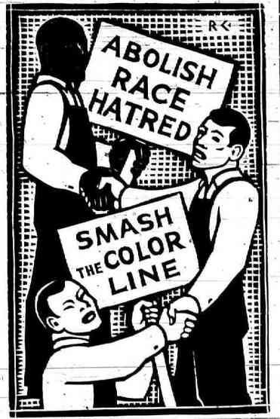
WW-II Crucible: Military conscription
https://www.youtube.com/watch?v=KxtThBTf0sI
https://www.youtube.com/watch?v=xckD780EYOY

